Slide 1
Citi bike program

Slide 2
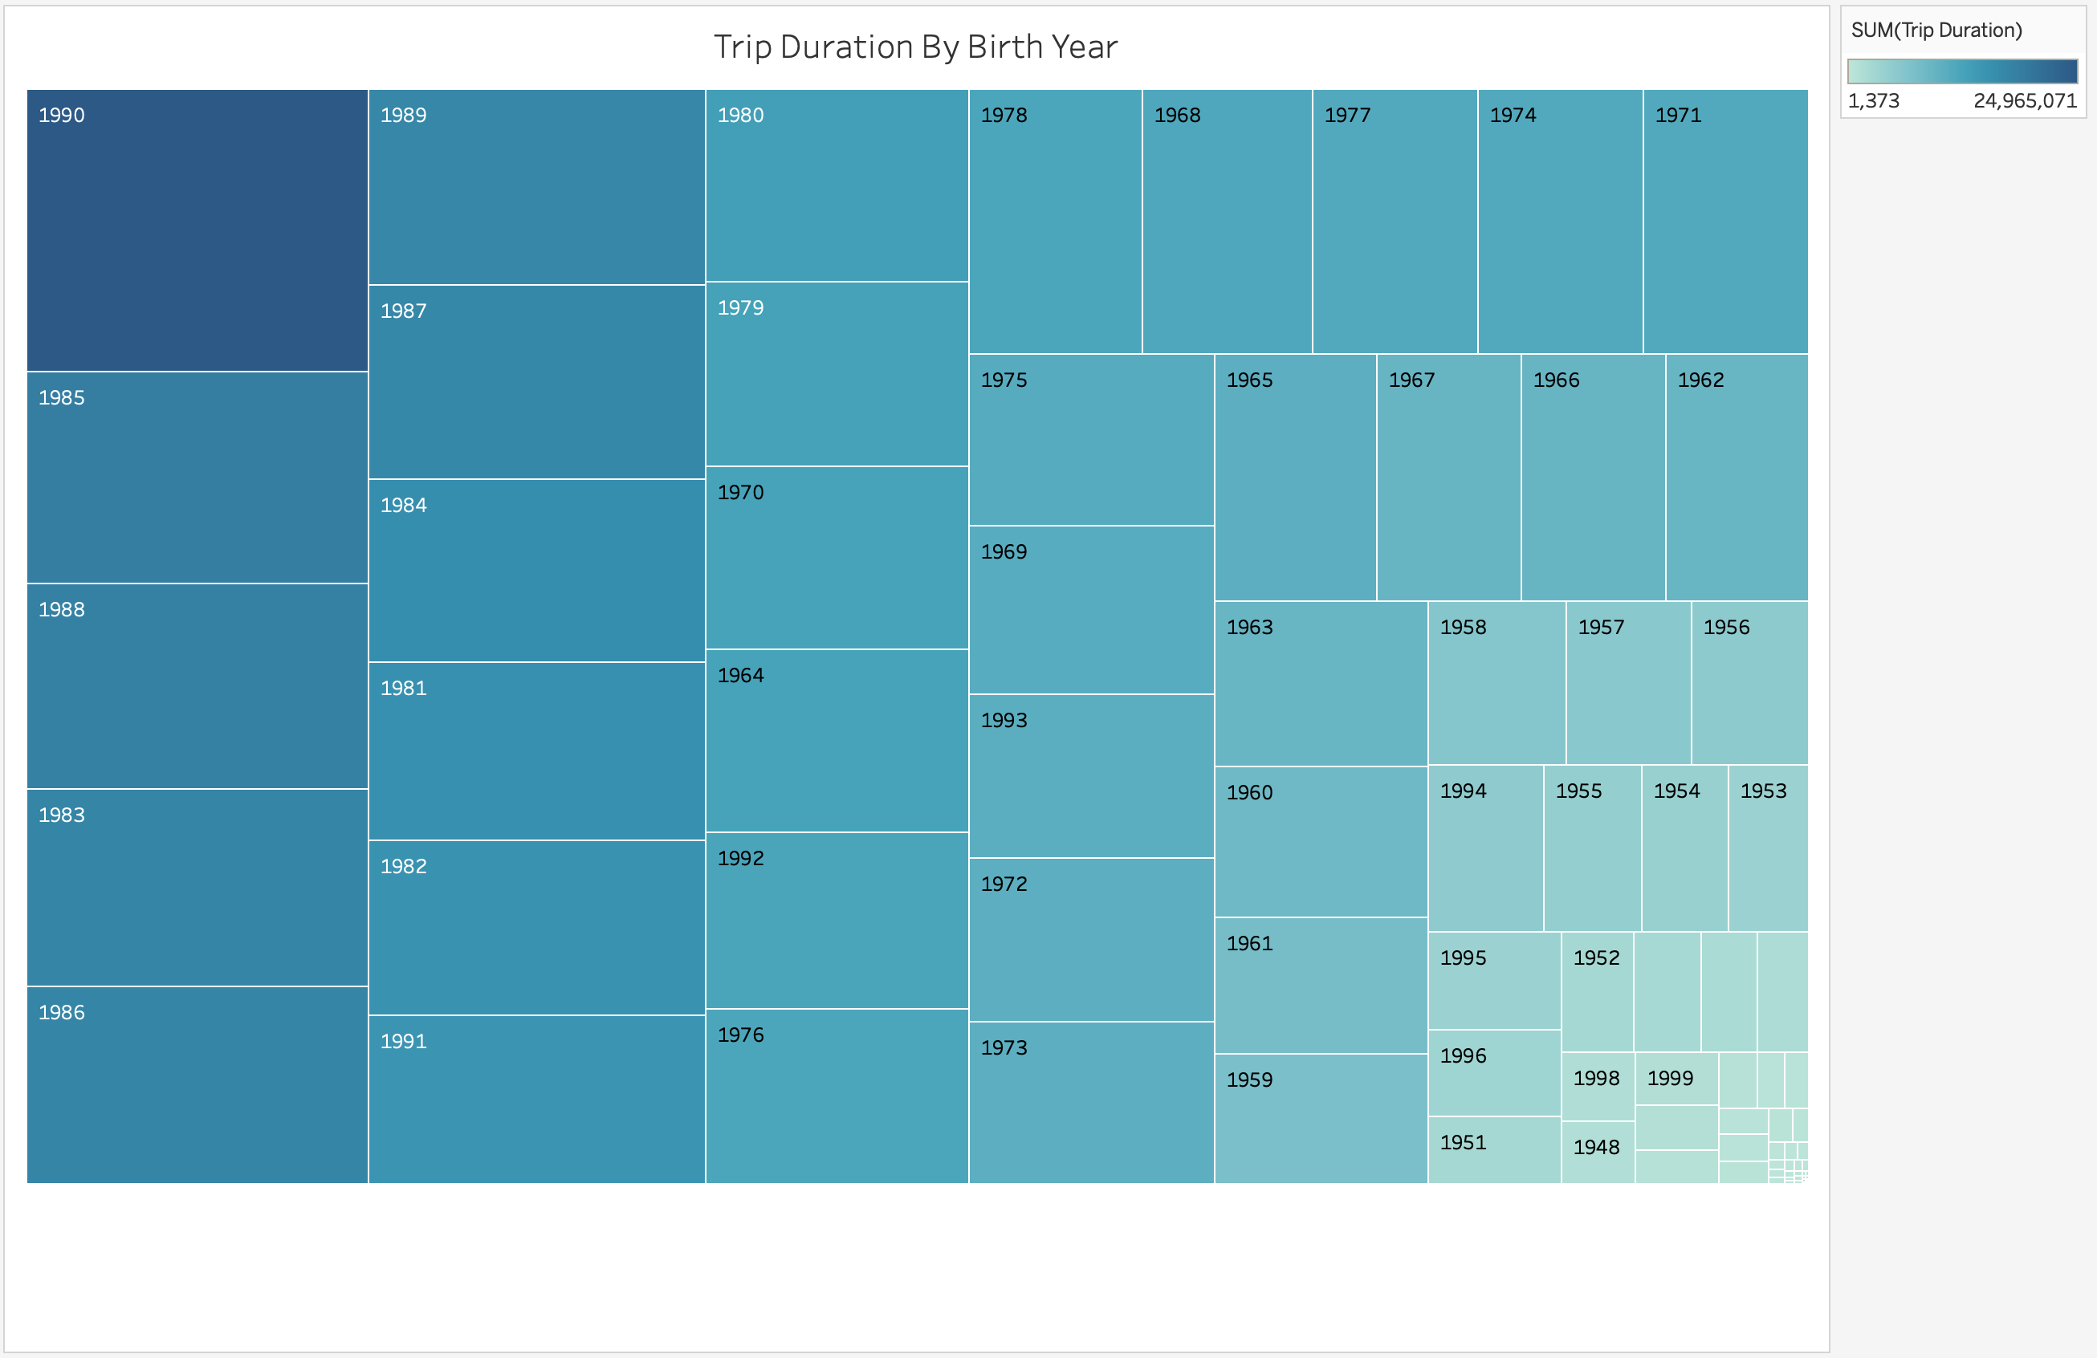

Slide 3
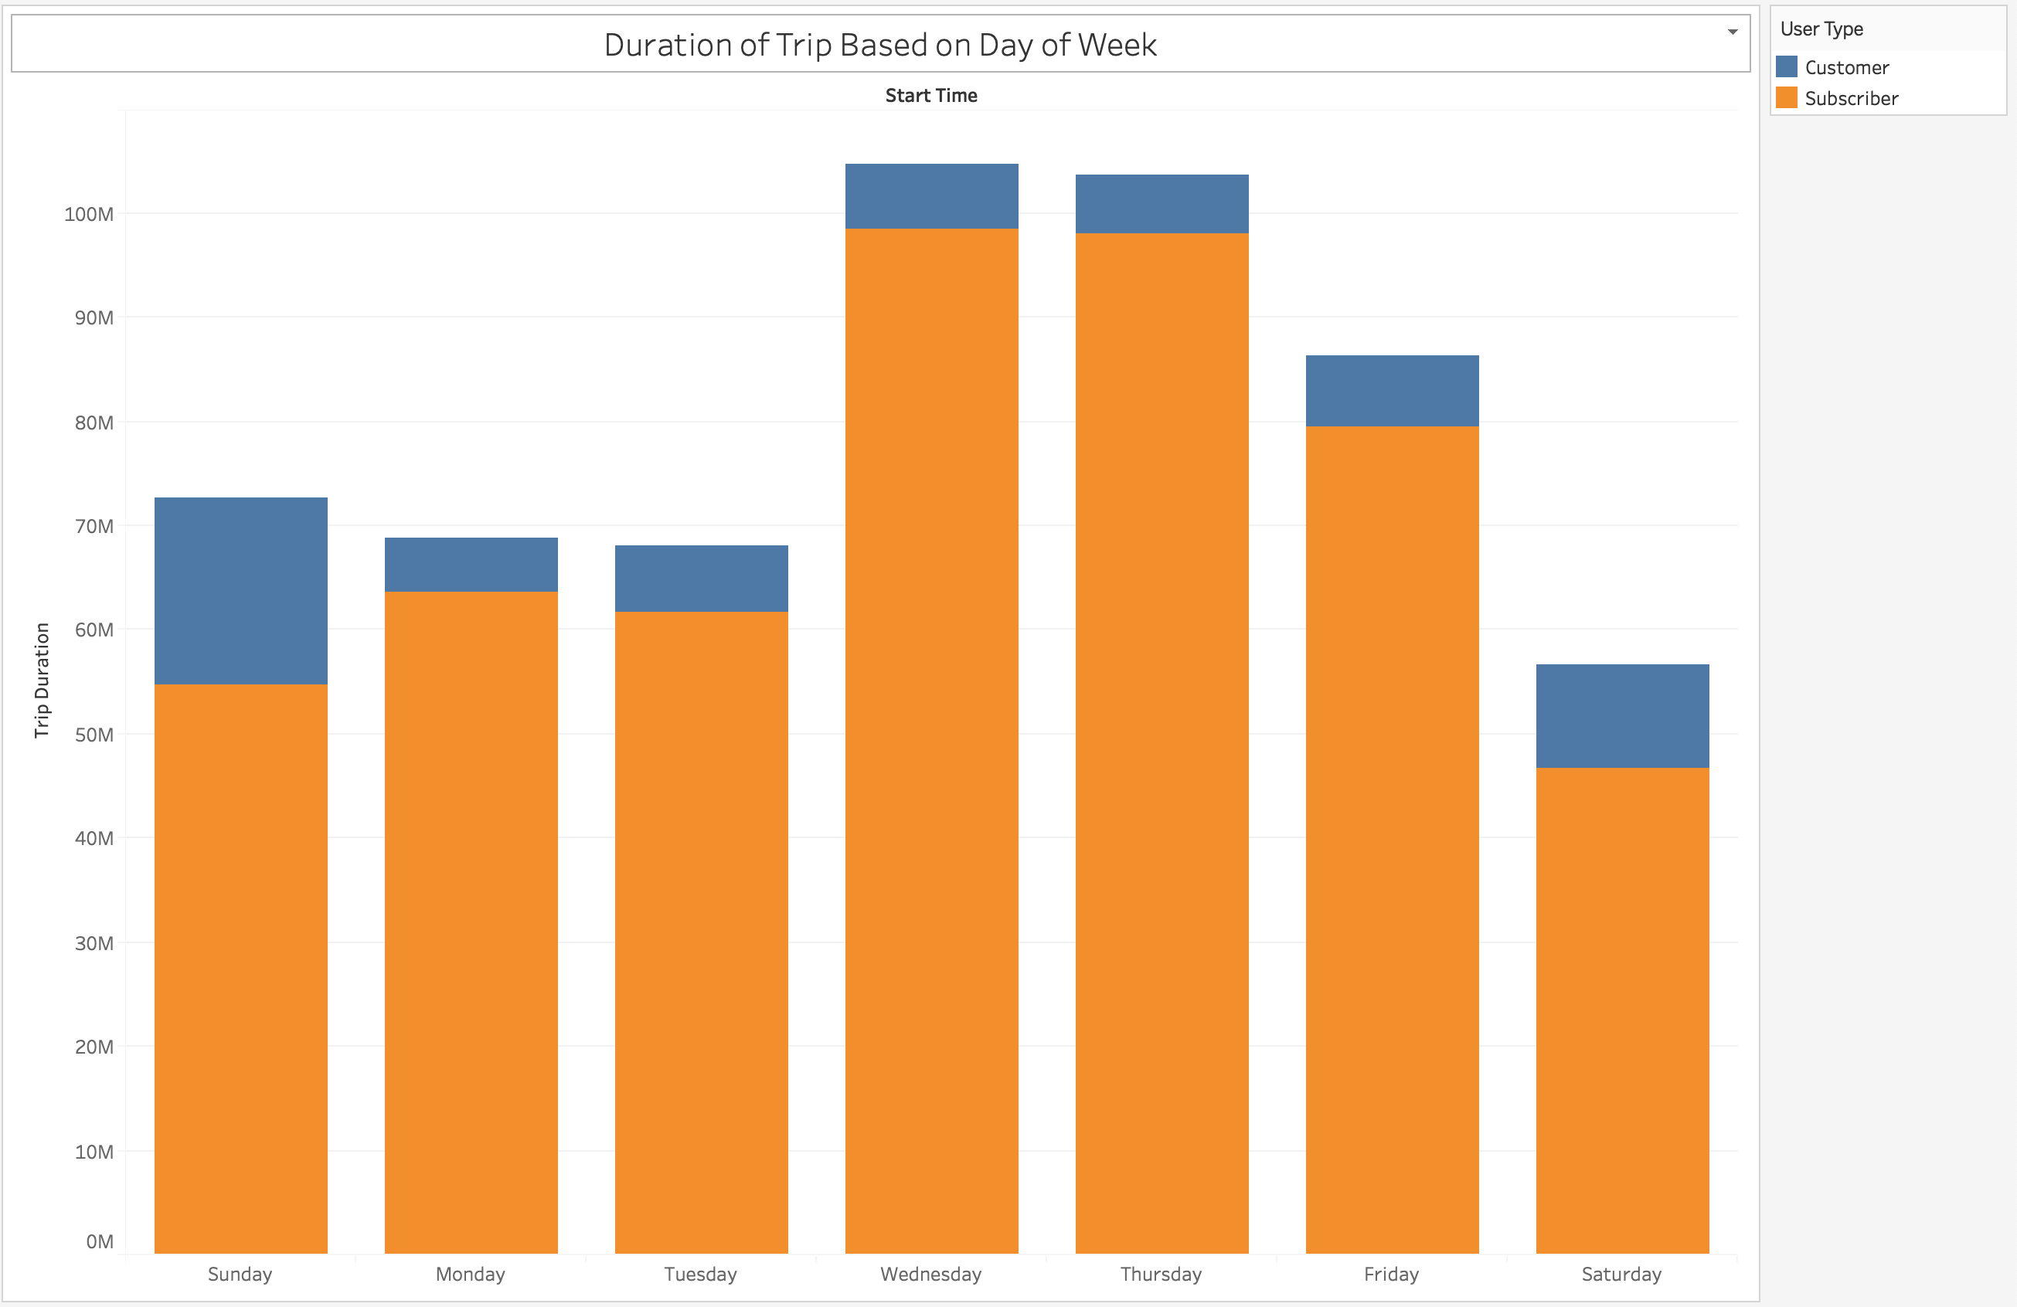

Slide 4
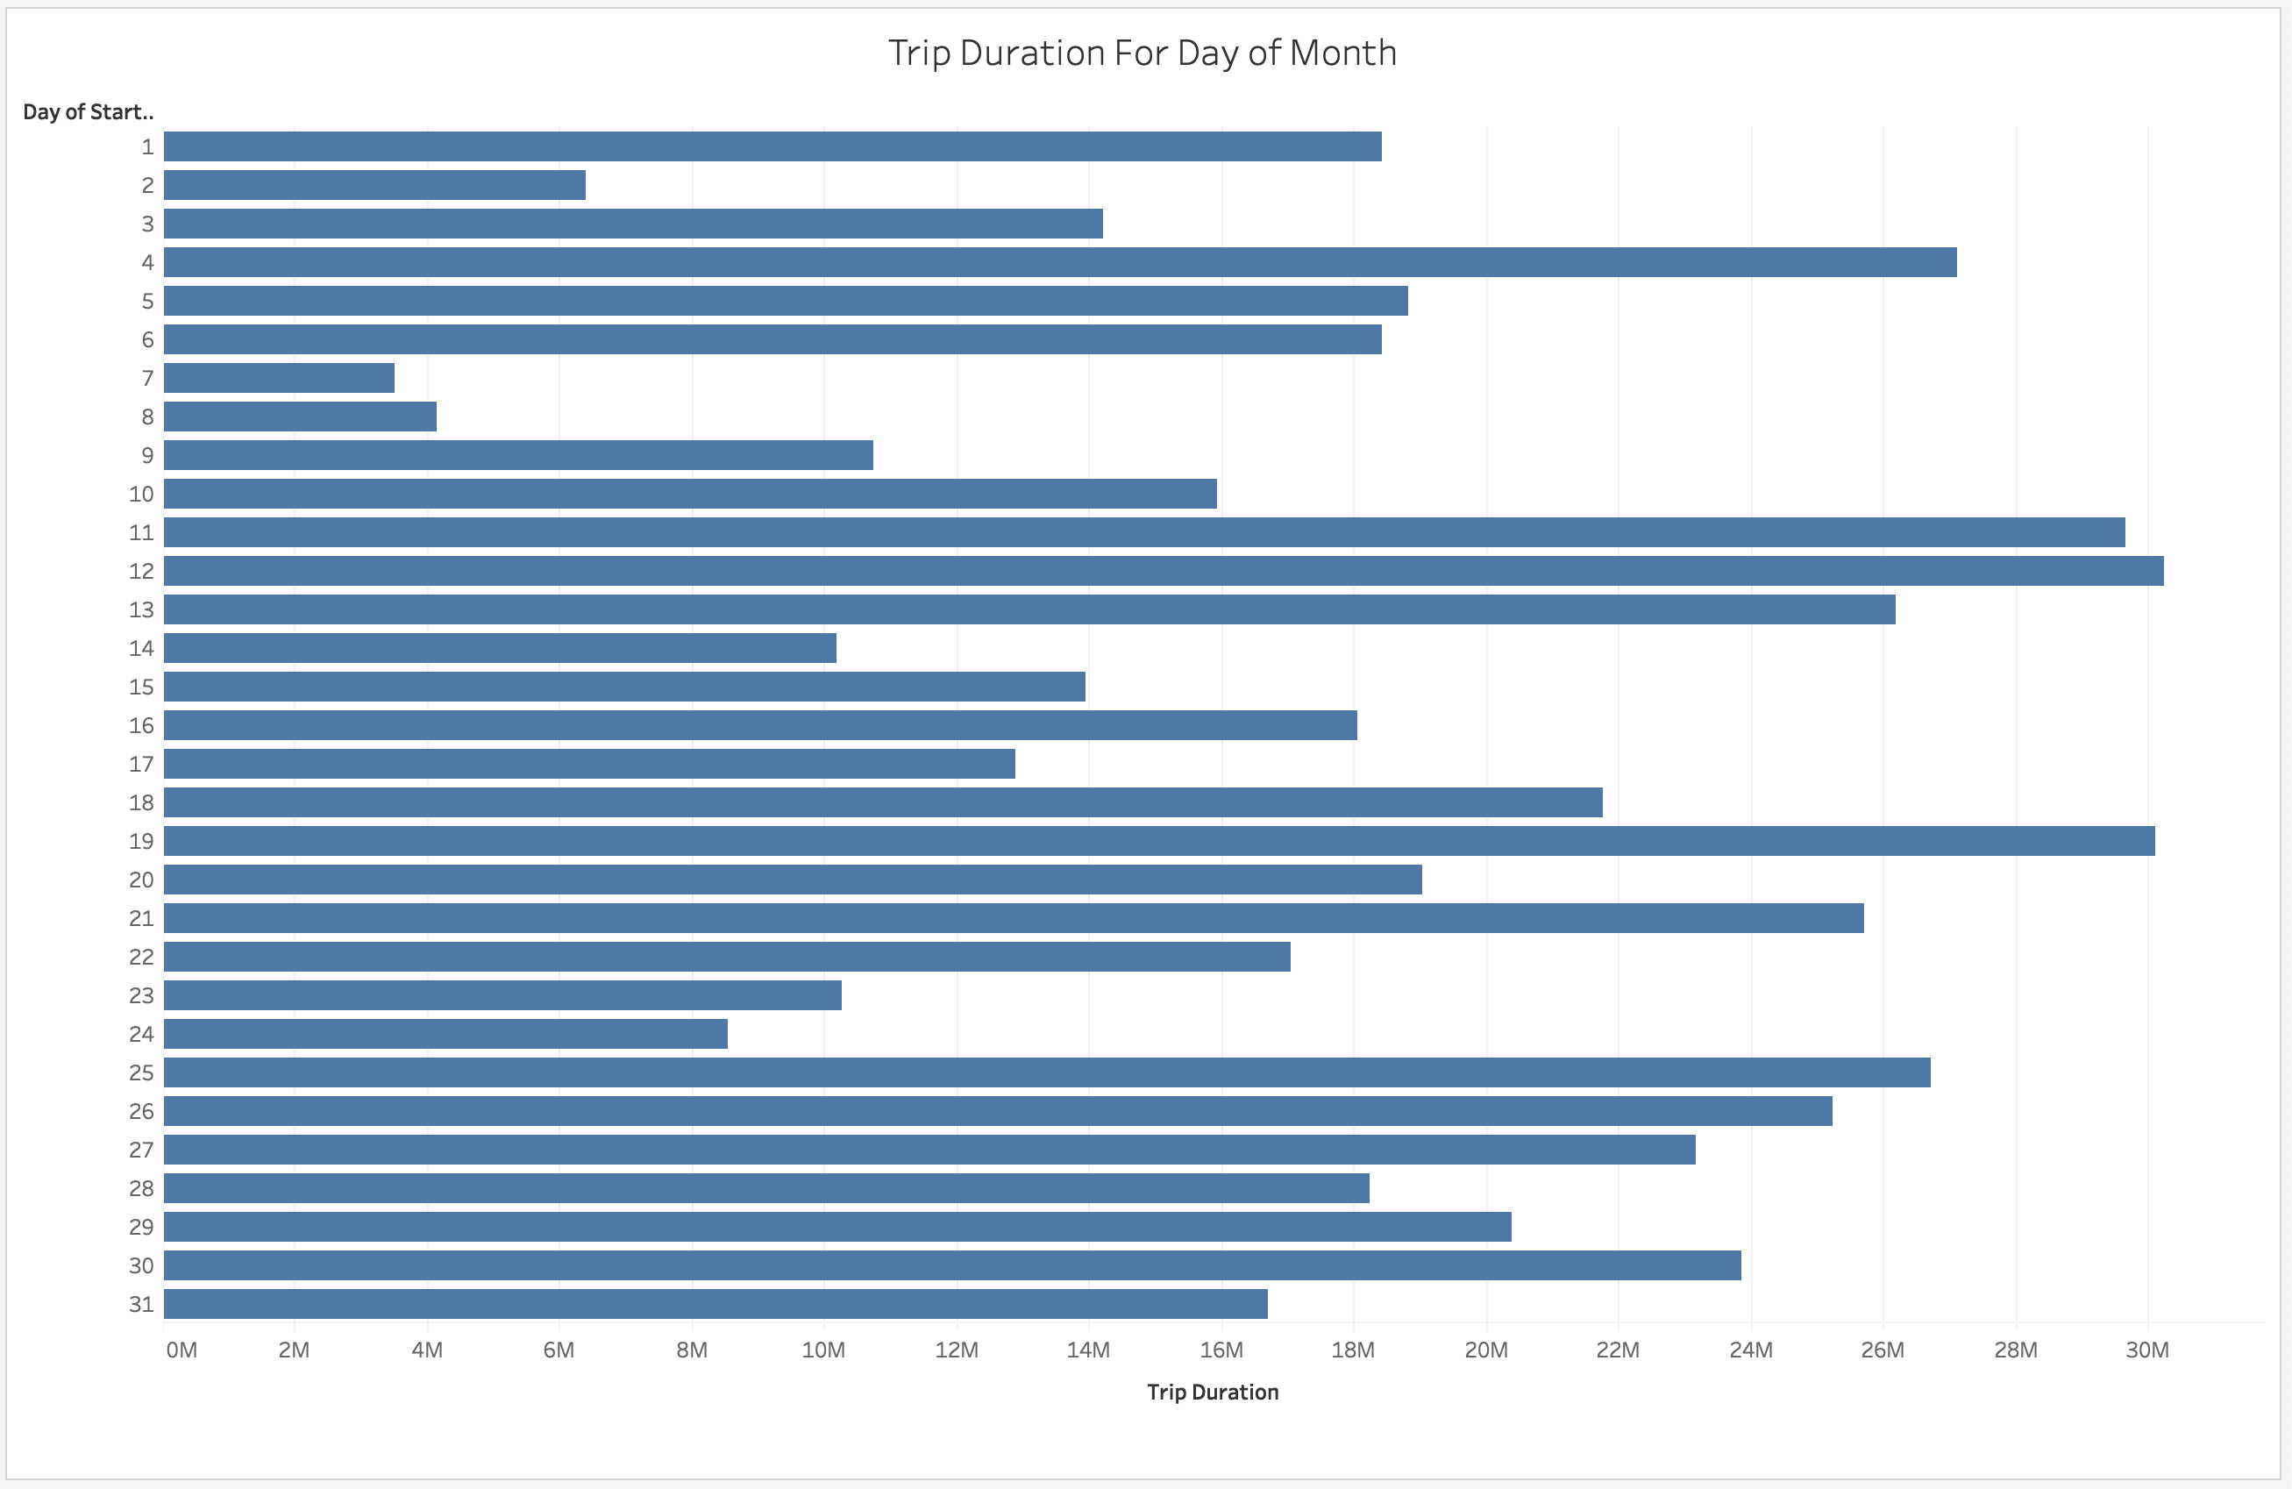

Slide 5
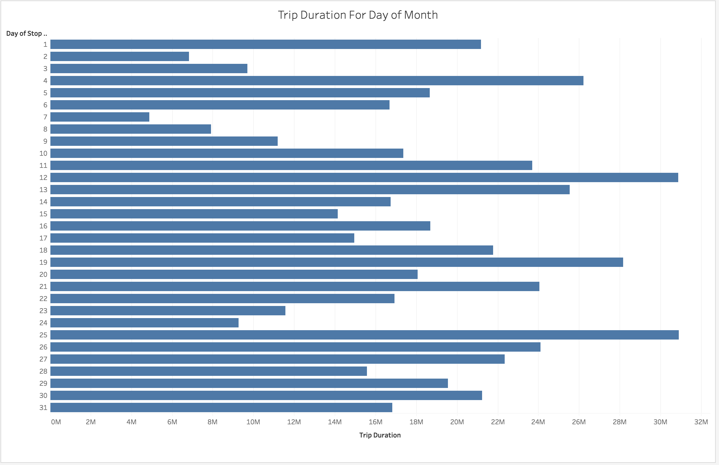

Slide 6
summary
People from 1990 are the largest users of the citi bike program.
People from the 1980s and 1990s also have the longest duration of using the bikes.
Subscribers overwhelmingly use the program compared to nonsubscribers.
The bikes are used the longest on Wednesday and Thursday, and used the least on Saturday.
The last two graphs show trip duration for start and stop time based on the day of the month. In this month, there did not appear to be a pattern on duration.

